Slide 1
Credit Card Fraud Project
Nisha Thiagaraj
Notes:
Hello! My name is Nisha and I was part of the Credit Card Fraud Project. Our project was about telling whether a transaction is fraudulent or not based on other variables in each case. Here is some of the work I did for it.

Slide 2
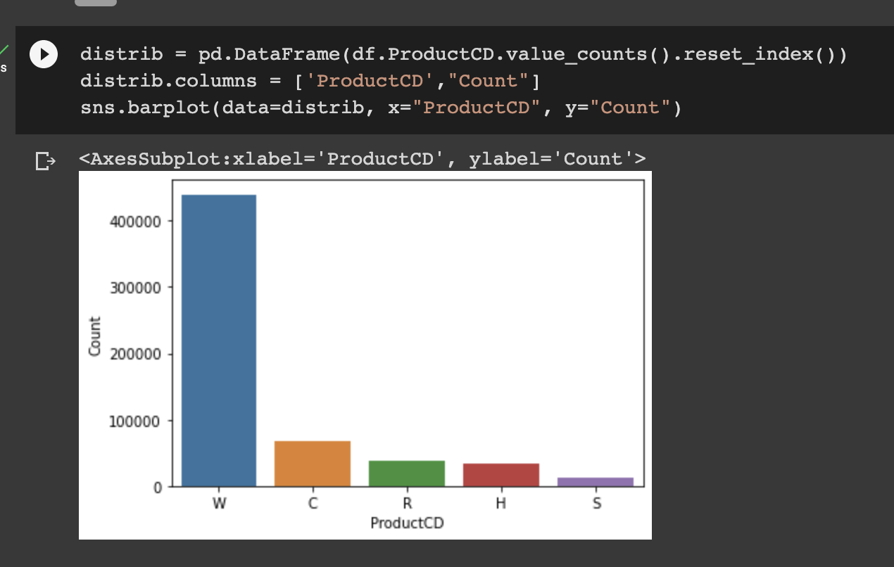
Visualizations - ProductCD Count
Notes:
First I made some visualizations. For one of the variables, I graphed a barplot. We can see that ProductCD count’s majority are W and C, with W being around 400,000.

Slide 3
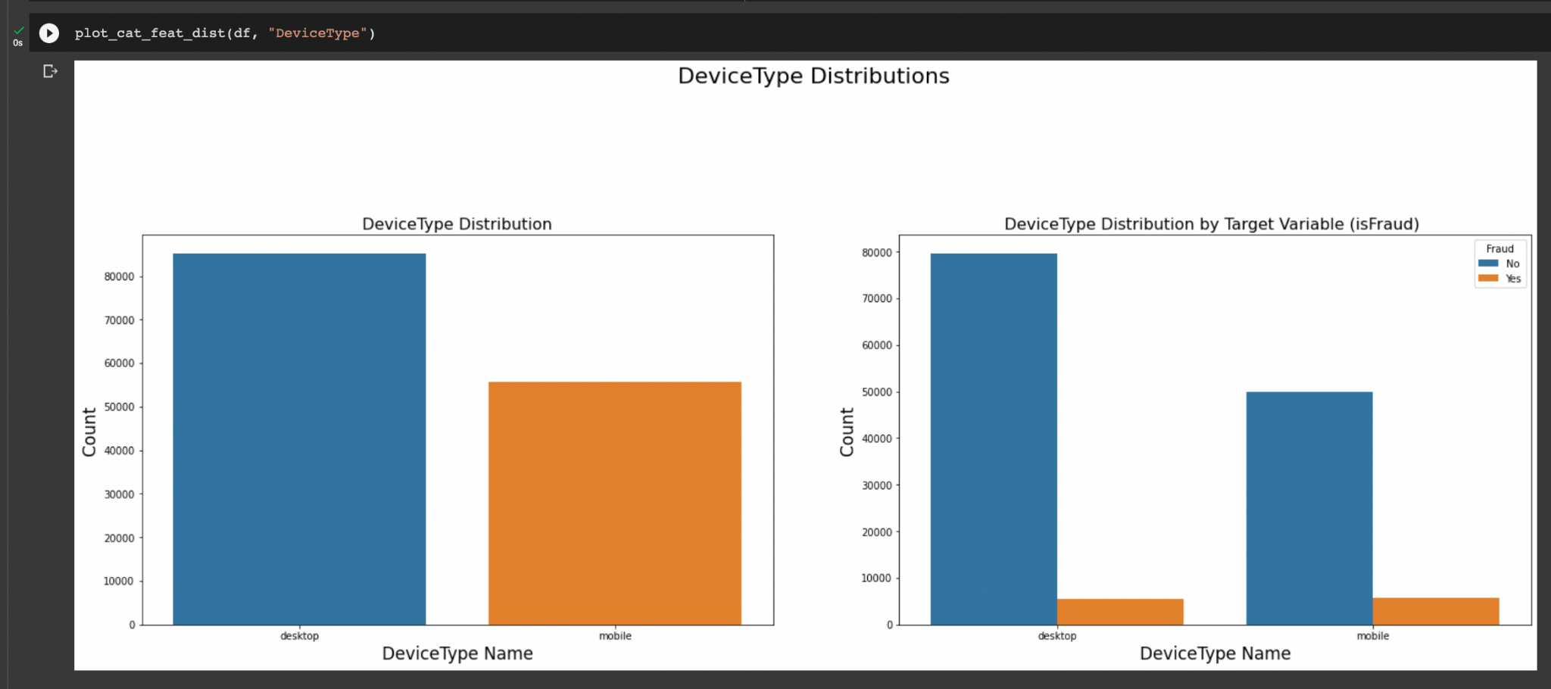
Visualizations - IsFraud Count Groupby Device Type
Notes:
Here are barplots of the device type that was used, which is then plotted against if the case was fraudulent or not. The distribution of the types are slightly imbalanced. It looks like the desktop and mobile fraudulent cases are around the same. But if you look more in depth at the percentages it will show that there is a larger number accounting for when the device type is mobile.

Slide 4
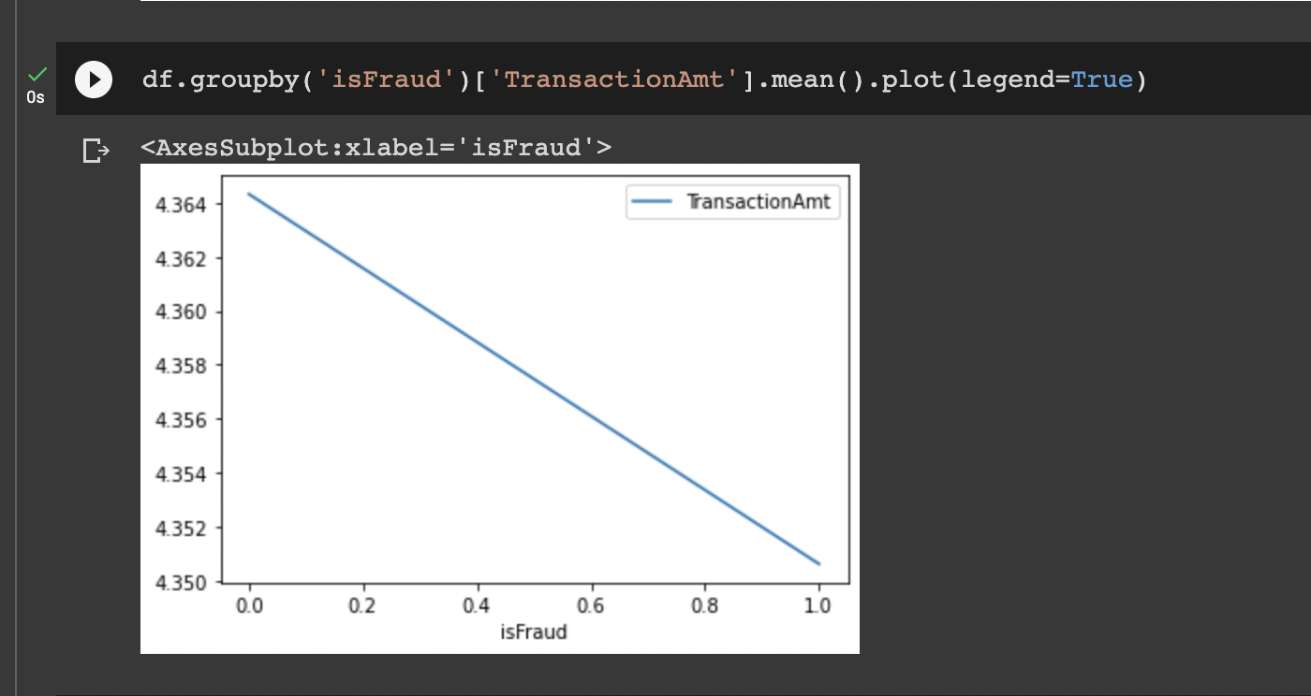
Visualizations - IsFraud vs TransactionAmt Mean
Notes:
This is a graph showing the mean of TransactionAmt for when there is Fraud versus when there isn’t. The mean of non fraudulent cases looks to be around 4.364 and the mean for fraudulent cases is around 4.350

Slide 5
Feature Engineering
The model - DecisionTreeClassifier
Keeps splitting based on criteria
To be 0 or 1
Won’t take NaN values
Fill in with mean
Loss of data vs. Outliers
Notes:
The model I used to fit the data is the DecisionTreeClassifier. What is the DecisionTreeClassifier? Imagine that you’re picking a restaurant - you have to consider the different types of cuisine, distance, and price. Eventually, you will have many categories with a combination of each cuisine, distance and price. Decision tree works like that. It keeps splitting each instance into groups based on their characteristics until it is able to be classified as 0 or 1. However the model can not take NaN values, so I chose to fill them in with the mean. This is so we don’t have to drop the columns, since that would result in a huge loss of data. However, there is a drawback to this. Mean is usually affected significantly by outliers and we do have some outliers in this data set, so it is not a completely accurate representation of data, but it still works well.

Slide 6
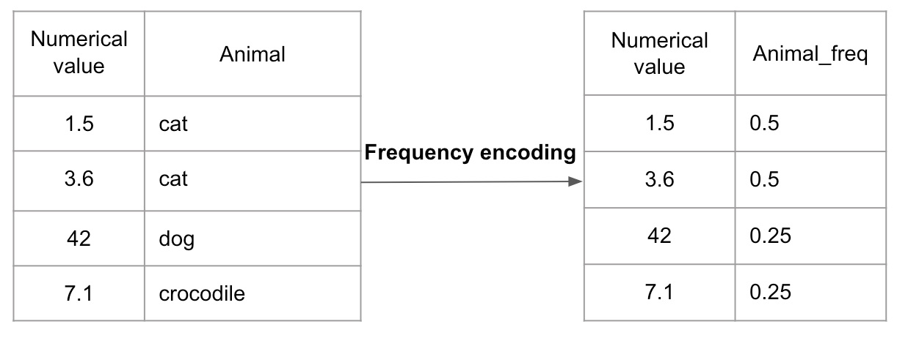
Frequency Encoding
Notes:
Also, the model can’t take categorical values. So frequency encoding had to be implemented. For the values that have strings or non-numerical data, frequency encoding changes the values into the frequency of which they appear. As we can see in this example since cat shows up twice out of four entries, it is changed to the percentage of how much it appears in the dataset which is 50%

Slide 7
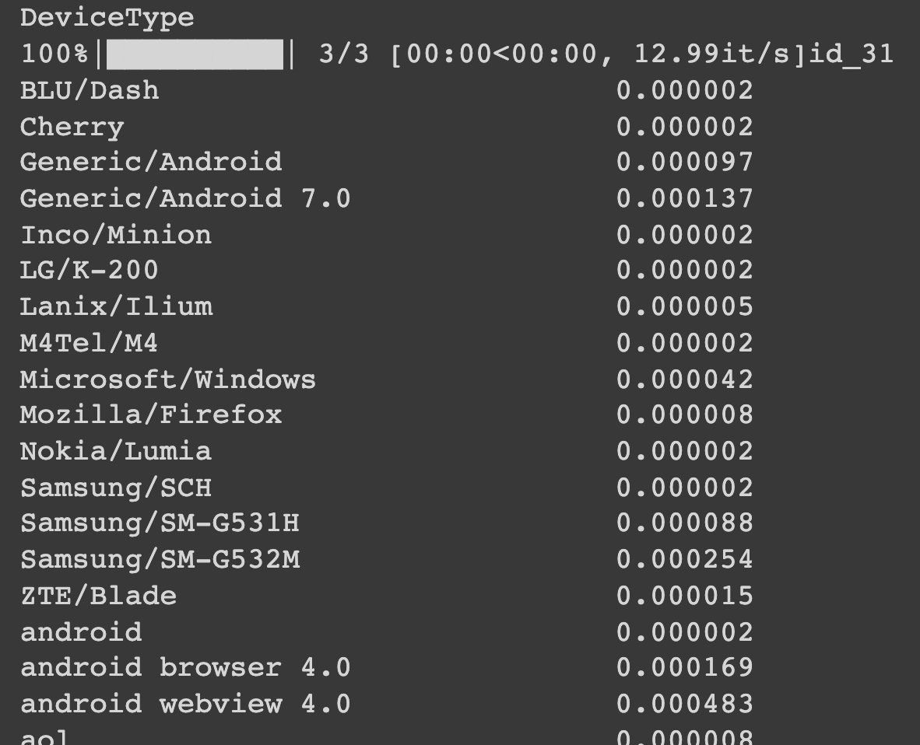
Frequency Encoding
Notes:
Here is an example in my code. The Device Types have been changed to the frequency of what they appear as.

Slide 8
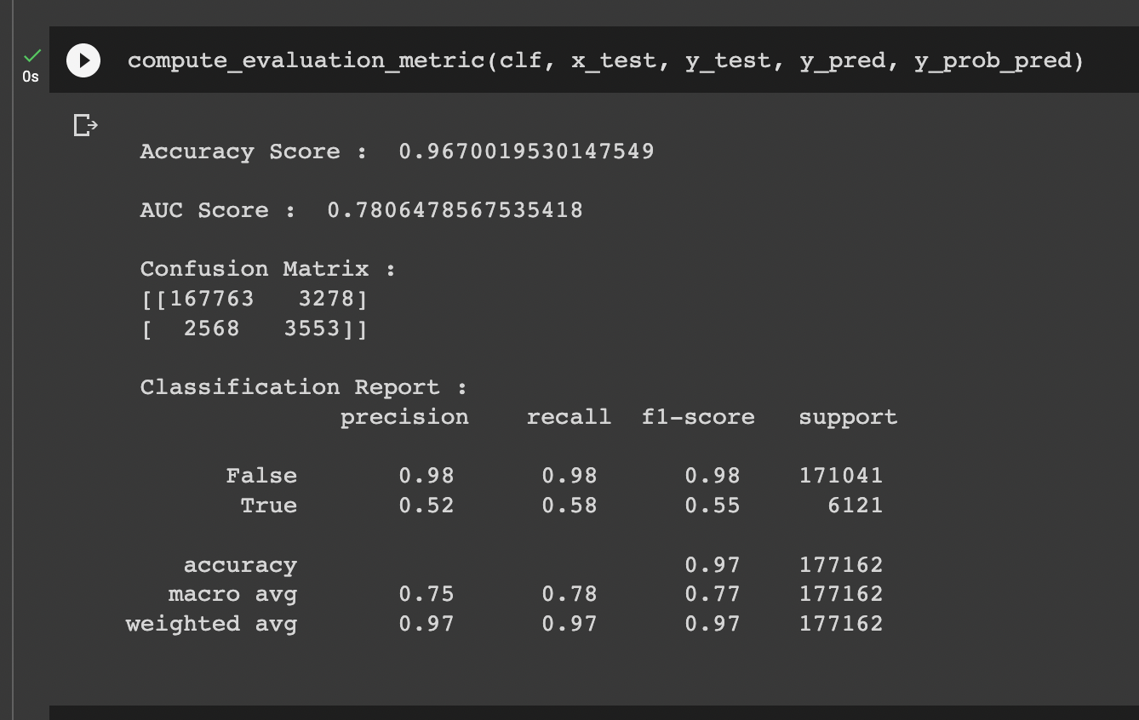
Model Results - Default
Notes:
Then it was time to fit the model. I split the data into two categories: train and test. The training data is used to do the fitting, it will see what characteristics and values in columns affect whether a case is fraudulent or not. The test data is what will be used to see if the model’s predictions are accurate. After fitting with the data and training it, the model predicted results for x_test. These results show how accurate it was. We will be looking at the f1-score to see how well the model did. The f1 score shows how many times the model accurately predicted fraud. Here we look at the the True row and see it is .55.

Slide 9
Hyperparameter Tuning
Hyperparameters - characteristics of model
Many parameters
Max_depth, criterion, class_weight
Best Model?
Notes:
One thing to note is that, the decision tree was fit with all the default hyperparameters. So what are hyperparameters? They are characteristics of a model that can be changed to get the best result. There are many parameters for this model, but I focused on the max_depth, criterion, class_weight. I tried different values for each parameter and it turned out that none of them had an f1 score that was higher than the default one. This is probably because of the frequency encoding. The proportions have already been accounted for, so the parameters will not really affect the performance. So the best model ended up being the one with the default parameters with the f1 score of .55.

Slide 10


